Slide 1
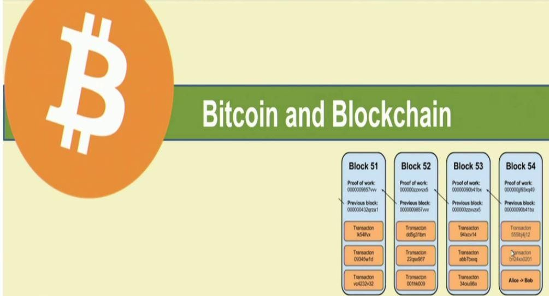

Slide 2

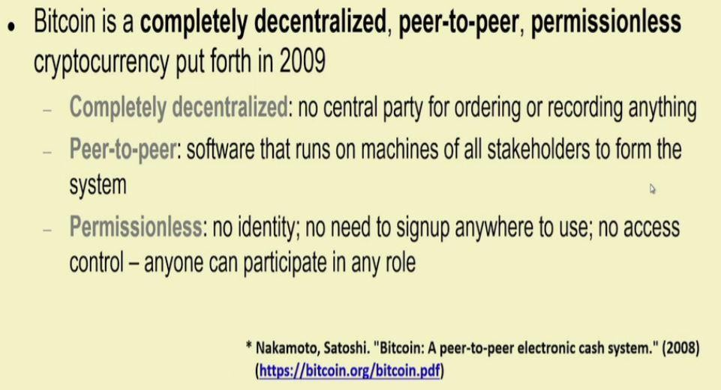

Slide 3

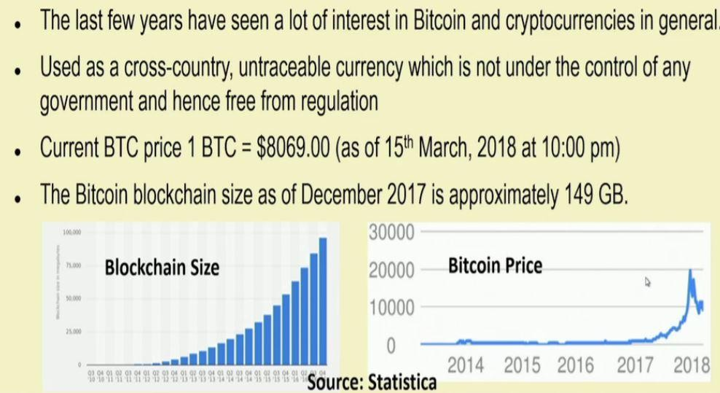

Slide 4
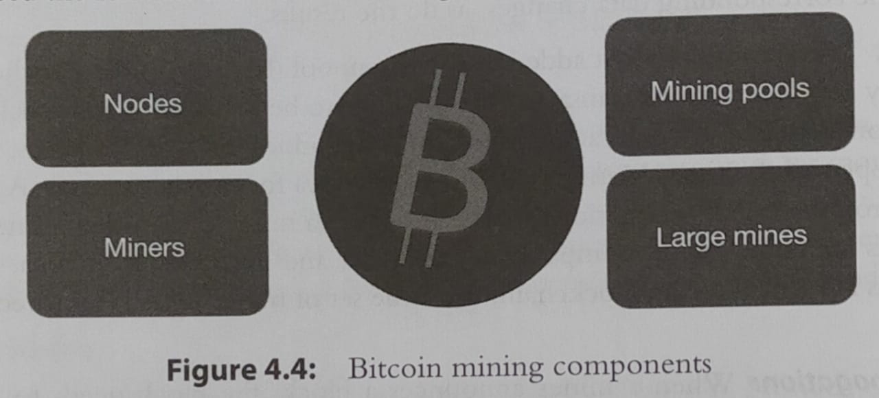

Slide 5

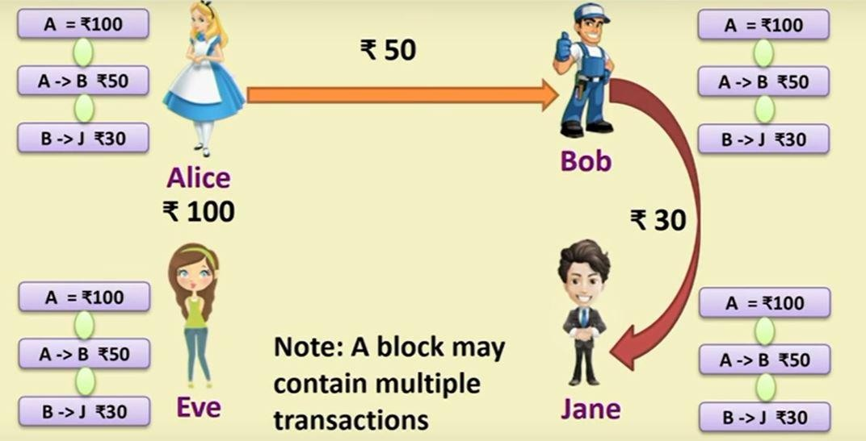

Slide 6

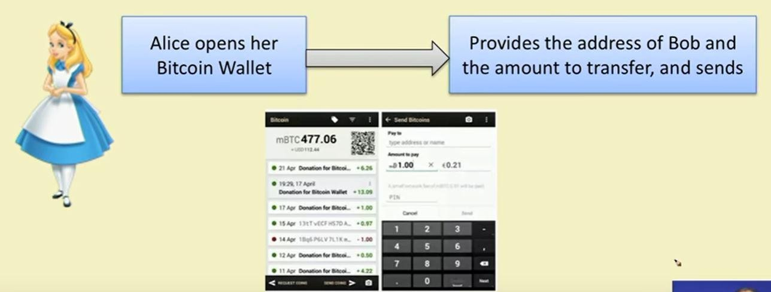

Slide 7

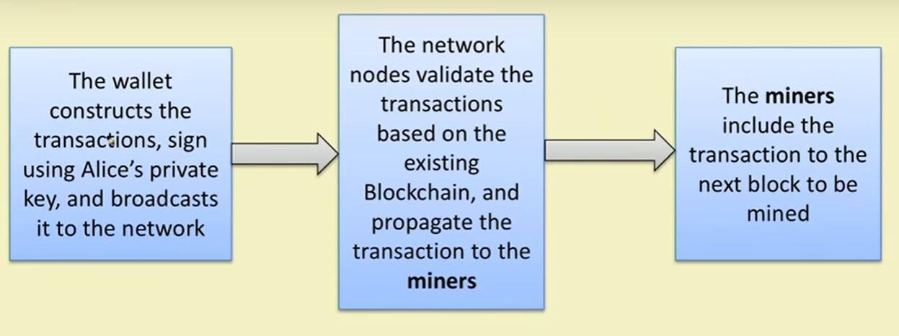

Slide 8

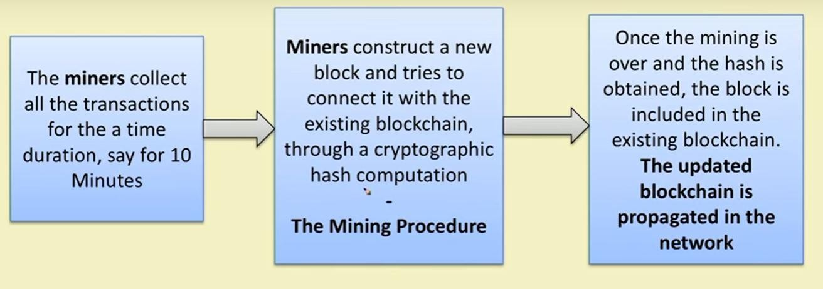

Slide 9

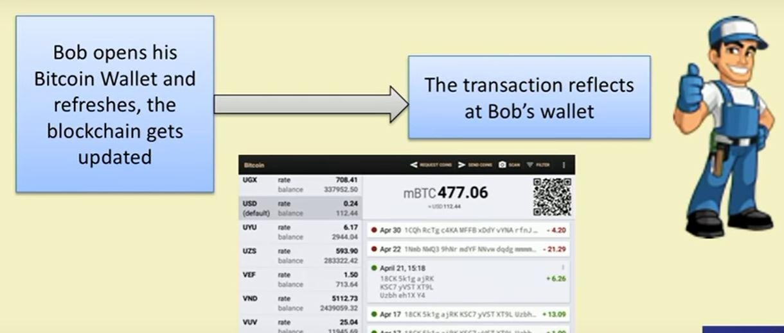

Slide 10
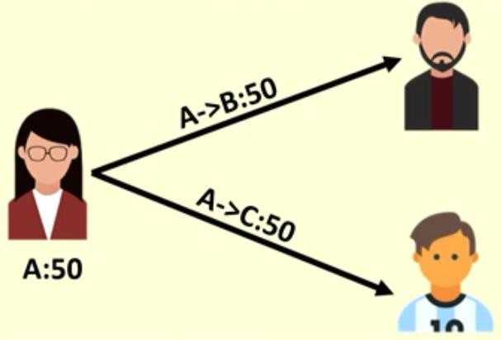

Slide 11
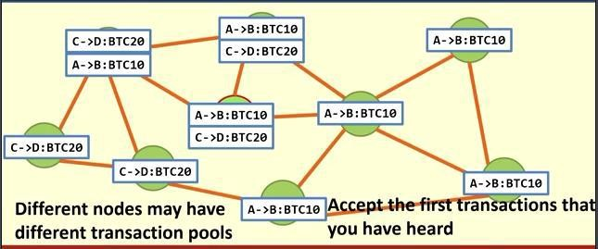

Slide 12
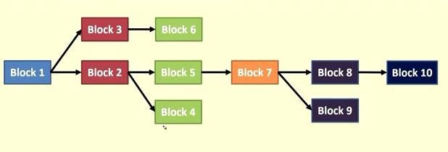
🞂 Bitcoin Block Propagation whenever a node is getting more than one copy of the blockchain ,it will accept the copy which has been transferred by maximum number of peers.

Slide 13


Slide 14
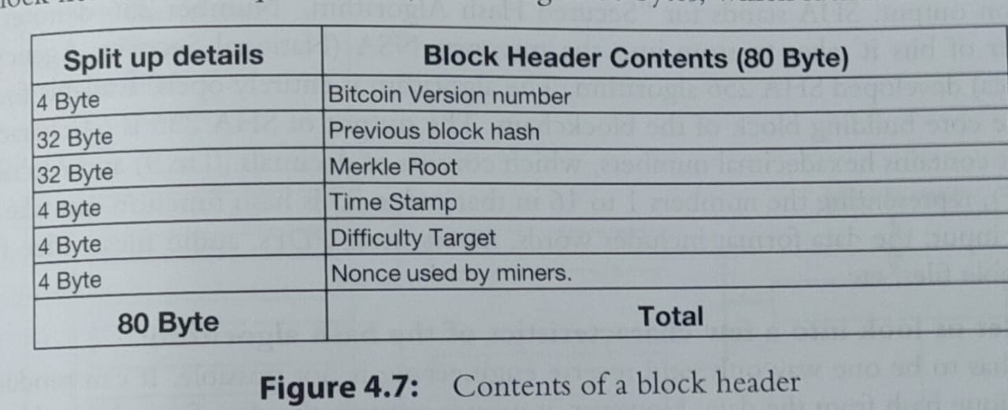

Slide 15
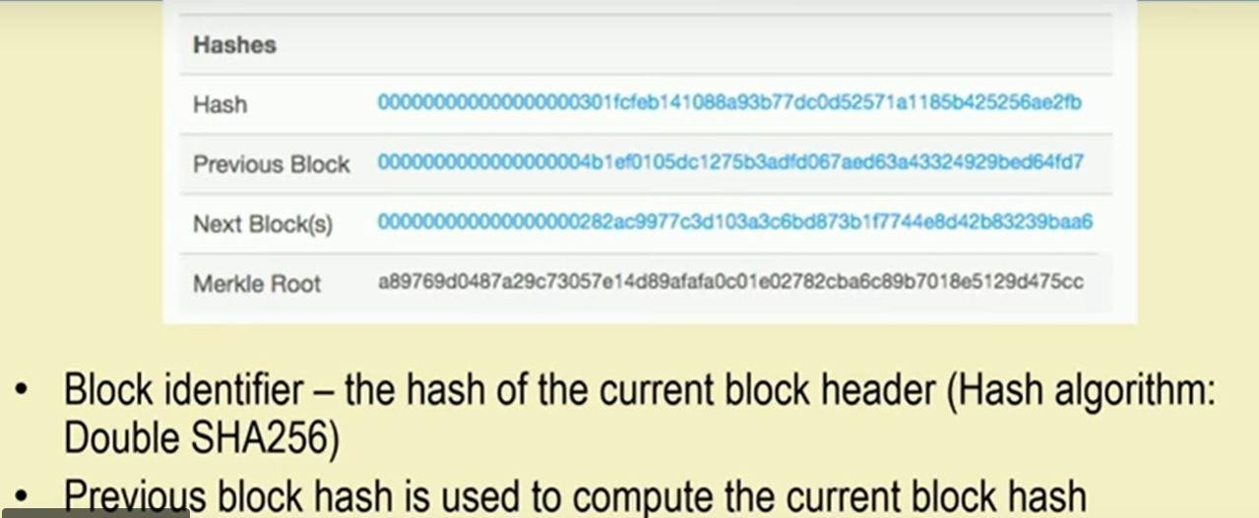

Slide 16
Industrial Mining
Mining Pool
6.25 bitcoin

Slide 17


Slide 18


Slide 19
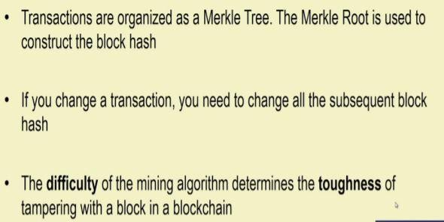

Slide 20
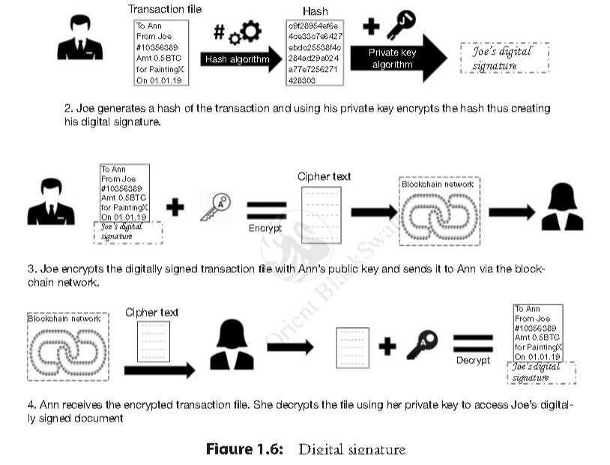
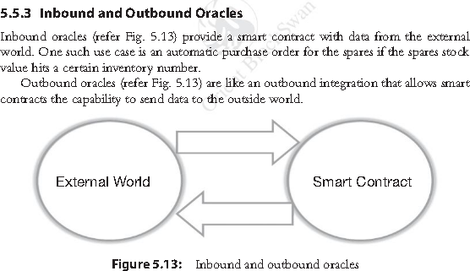

Slide 21
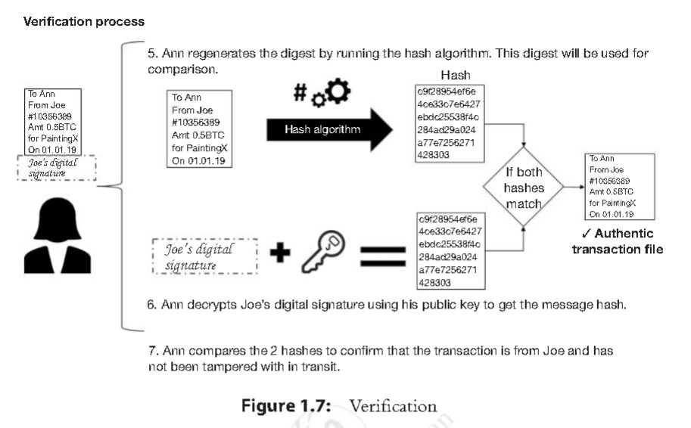

Slide 22
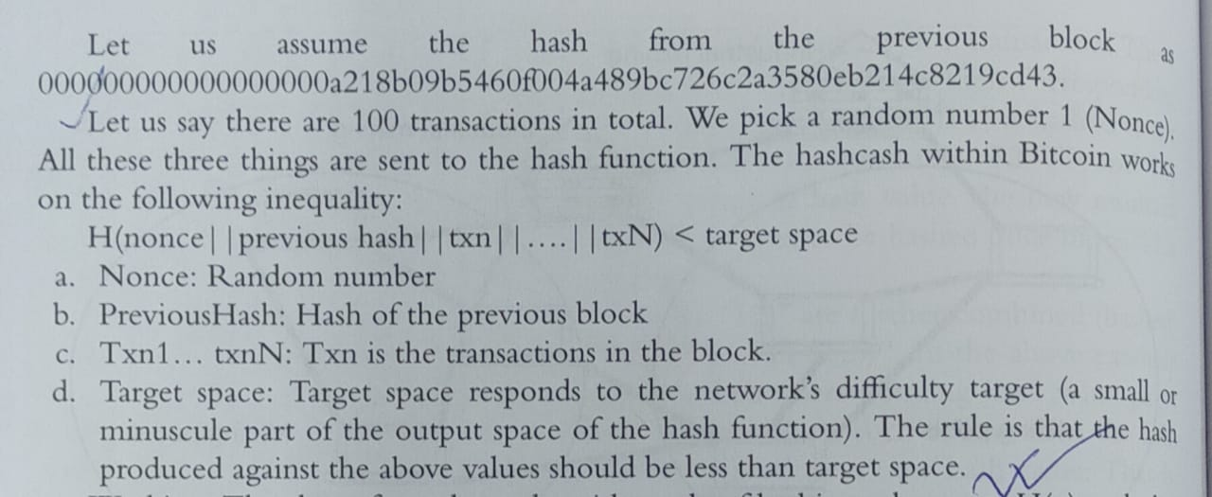
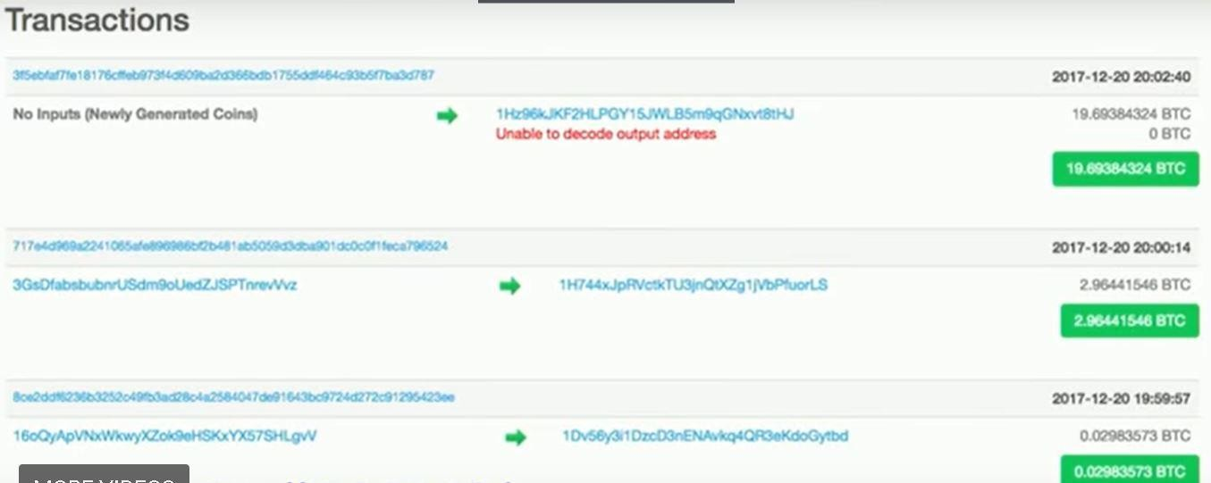

Slide 23
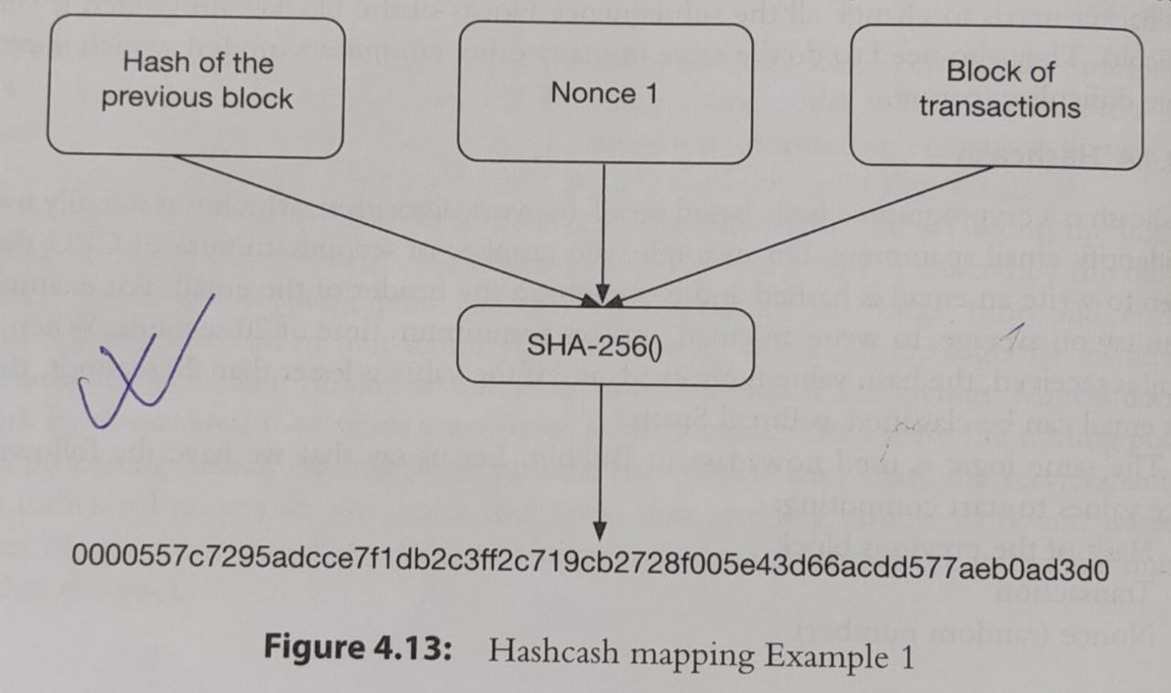

Slide 24
Hash each digit 16v types of number ranging from 0 to 9 and A to F
Assuming there is N = 16^64= Population Hash Set
Target Hashset 18 leadig 0
Target Hashset= 16^(64-18)
Probability that random hash= Target Hashset/ Population Hashset= 2*10^-22
Nonce=32 bit unsigned integer
Maximum Nonce=2^32
Limit between 0 to 2^32= 4*10^9
Prb that one of them valid=4*10^9 * 2*10^-22
40 second

Slide 25
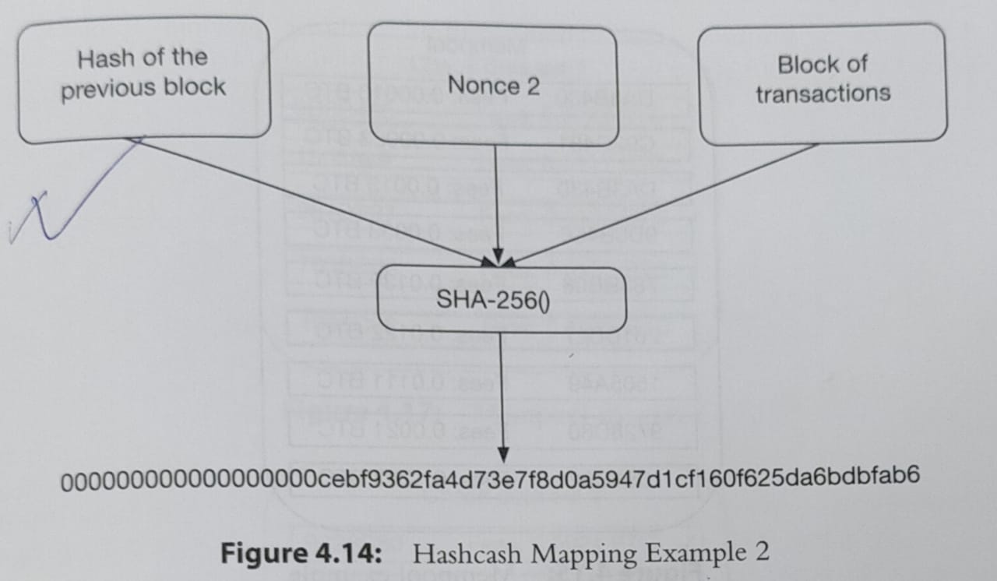

Slide 26
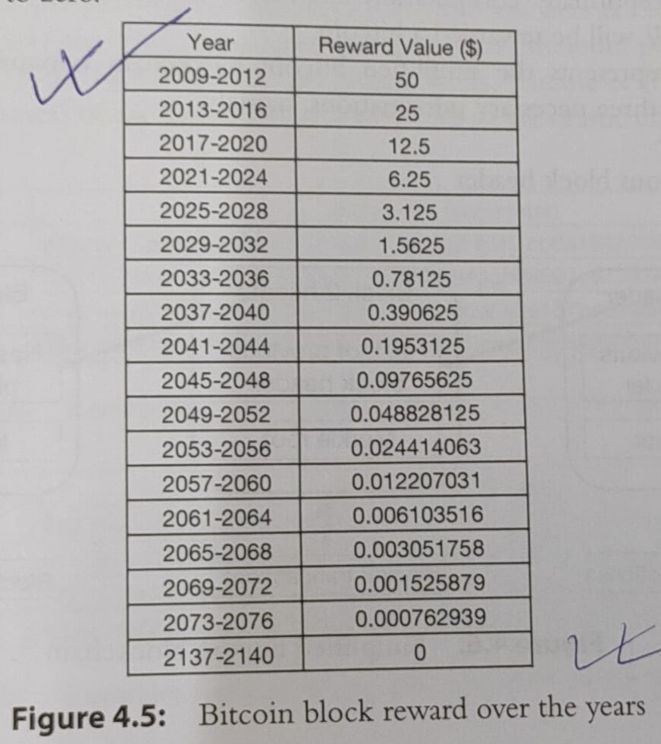

Slide 27
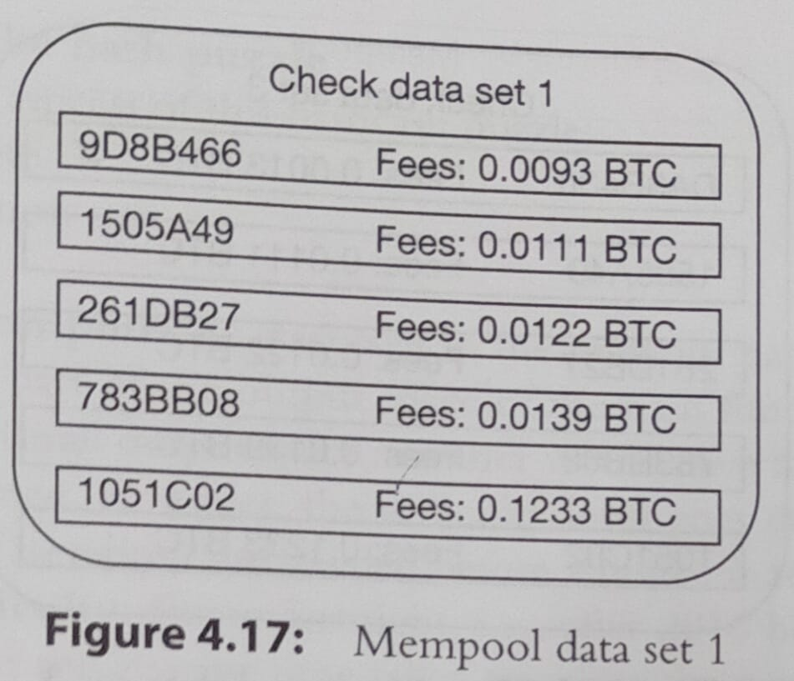

Slide 28
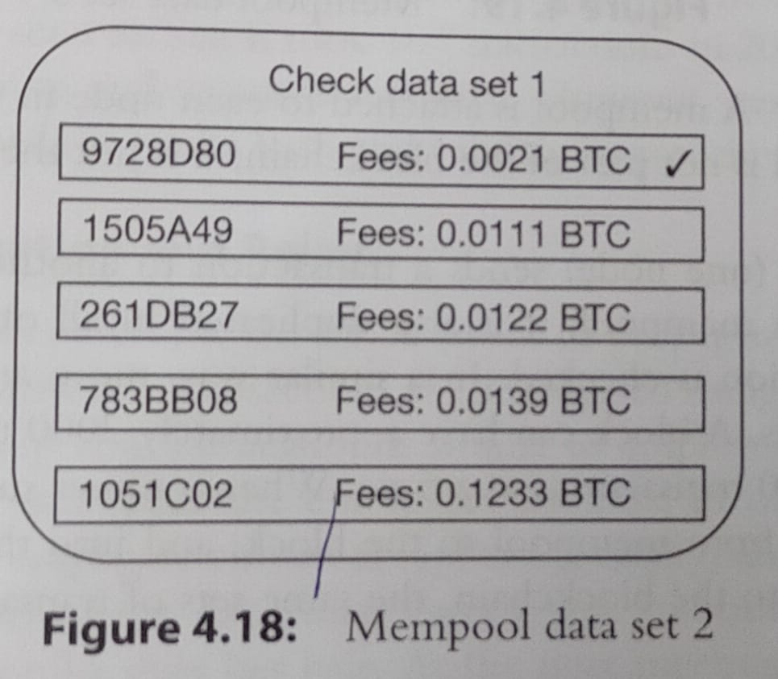

Slide 29
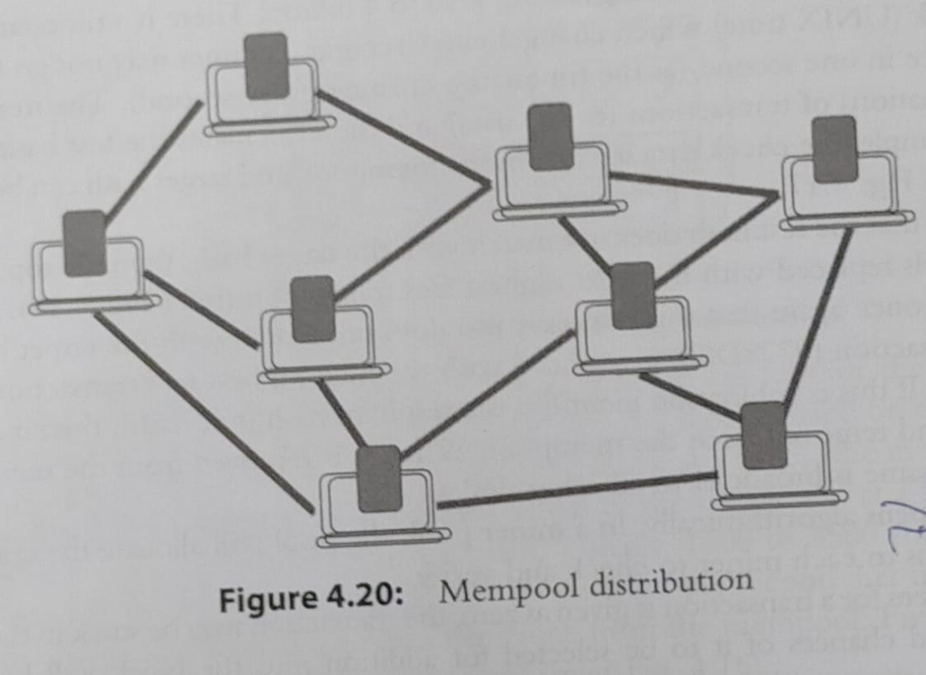

Slide 30
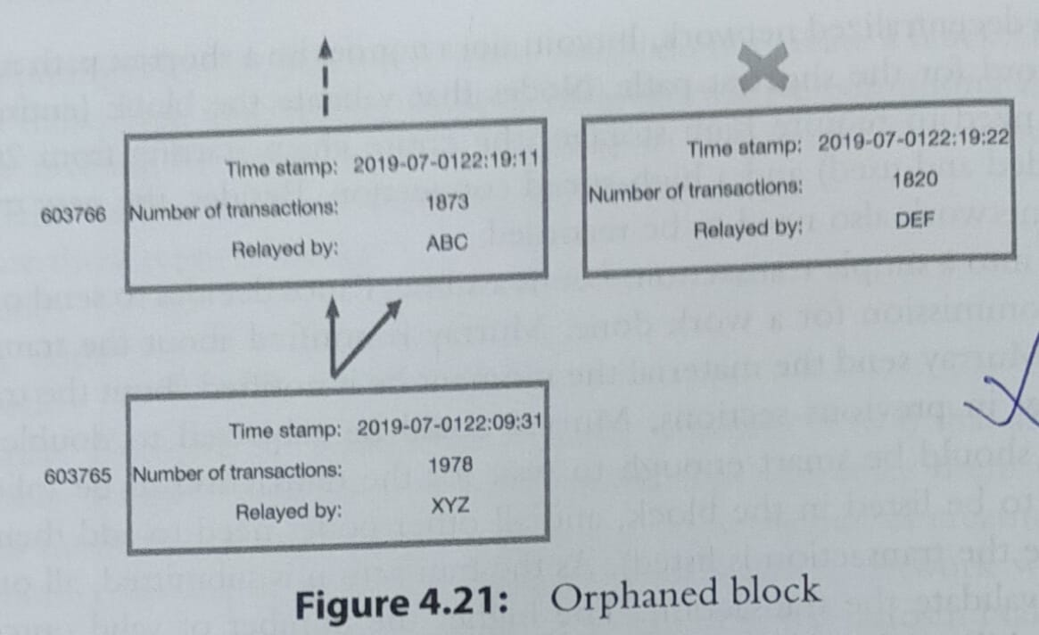

Slide 31


Slide 32
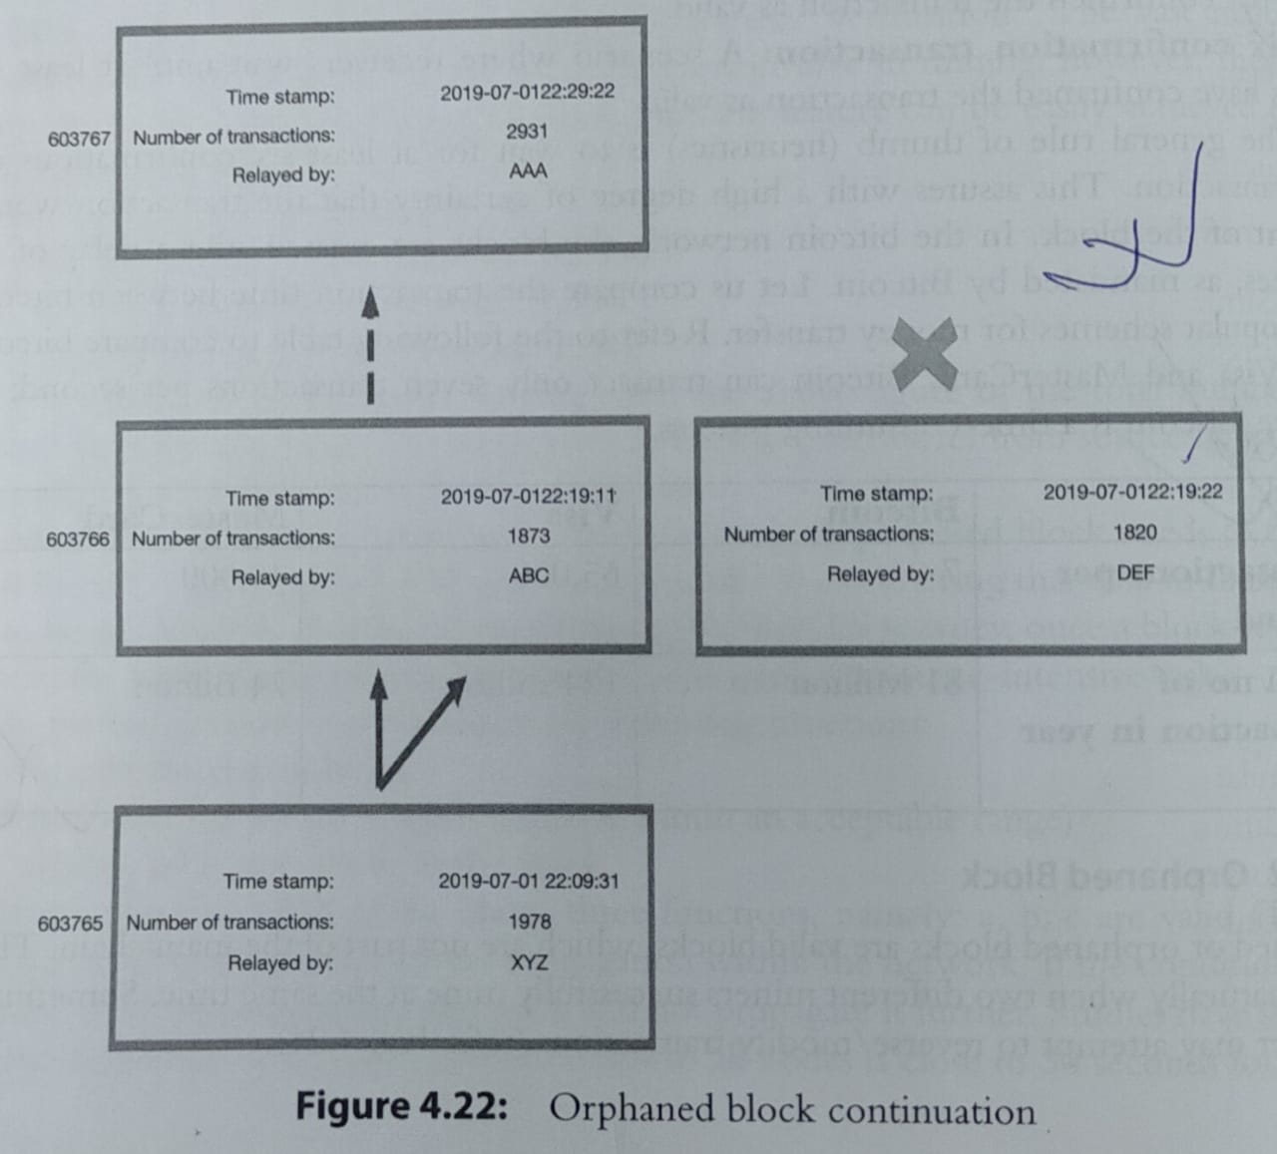

Slide 33
